Slide 1


SERVICES PROCUREMENT
Coupa Supplier Portal (CSP)
Supplier Training

Slide 2







AGENDA
SERVICES PROCUREMENT
01.
Introduction to
Services Procurement
• Training objectives and scope
• Solution overview
02.
Process Benefits
• What changes with Services Procurement?
• Benefits of the new process
03.
End-to-end process
• Overall process flow
• Interaction with Cerrejón
04.
Service Orders
• Accessing Service Orders
• Reviewing and tracking information
05.
Service Entry Sheets
(SES)
• Recording completed services
• Attach reconciliation certificate
• Submit for approval
06.
Invoicing
• Invoice creation
• Submitting invoices
07.
Next Steps
• Project timeline

Slide 3






Training Objectives
By the end of this training, participants will be able to:
Access and navigate the Coupa Supplier Portal (CSP).
View the Service Orders issued by Cerrejón.
Record Service Entry Sheets (SES).
Attach the required supporting documentation.
Create and submit invoices for previously approved services.
Track the status of their transactions within Coupa.
Scope of this training
Viewing
Service Orders
Recording
Service Entry Sheets (SES)
Attaching the
Reconciliation Certificate
Creating and submitting
Invoices
Transaction
tracking

Slide 4





What is Services Procurement and what does it include?
Services Procurement is the new service-management model in Coupa that lets you manage, validate, and track contracted services in a digital, traceable, and centralized way.
Benefits
→
→
→
From direct invoicing
Greater control
A more organized
to
and
and
service recording
traceability
predictable
Before
Before
Before
Invoicing without structured validation.
Low visibility between the service provided and the invoice.
Adjustments, rework, and discrepancies.
Now
Now
Now
Recording via a Service Entry Sheet (SES) before invoicing.
You will know the detail and status of the services executed and approved.
A single source of information and consistent criteria for everyone. Invoices are linked to previously validated services.

Slide 5




End-to-end process
How services are recorded, validated, and invoiced
1
2
3
4
5
Contract
Service Order
Execution
Service Entry Sheet (SES)
Invoice
Cerrejón will issue the contract with the agreed rates and terms.
Cerrejón will issue a service purchase order with the schedule for the period.
The Supplier submits the invoice through the approved Service Entry Sheet (SES) in Coupa for review and payment.
The Supplier performs the services requested by the Contract Administrator.
The Supplier will record the executed services in Coupa, in accordance with the agreed rates and terms, for the administrator’s approval.
» All information is recorded in Coupa from start to finish.
A process designed to provide visibility, control, and confidence across every service delivered.

Slide 6








Who performs
this activity?
Service Orders
Supplier
This scenario explains how to view the Service Orders issued by Cerrejón and access the information needed to perform the services.
Objective
Scenario 1 – Viewing Service Orders
Service Orders display the authorized services, execution periods, and agreed delivery terms.
Instructions
Why is it important?
Log in to the Coupa Supplier Portal (CSP).
1
✓ Lets you see the services authorized by Cerrejón.
✓ Makes service planning and execution easier.
Open the available Service Orders.
✓ Provides visibility into the information needed to record the Service Entry Sheet (SES).
2
3
Review the Service Order details.
Expected result
Service Order reviewed and available for execution.
Review the information associated with the service.
4
Important
Screenshots
The Service Order is the basis for recording the Service Entry Sheet (SES) and for the subsequent invoicing.
The following screens will guide you through this process.

Slide 7
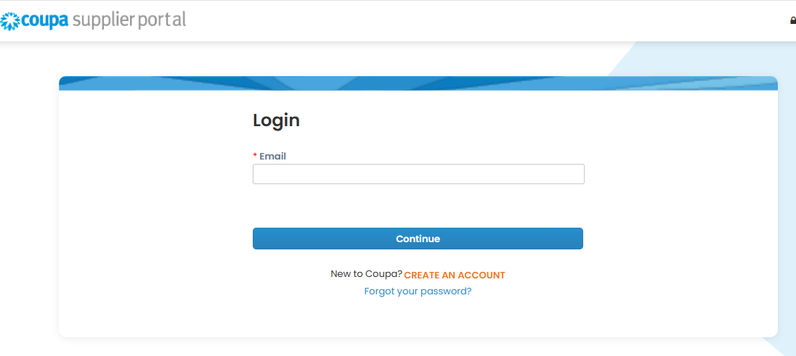
Coupa Supplier Portal – Step 1: Log in
Instruction
Enter your registered email address and select Continue to access the portal.
1
2
1
Email field
Enter the email address you were registered with in the system.
2
Continue button
Click to continue the login process.

Slide 8
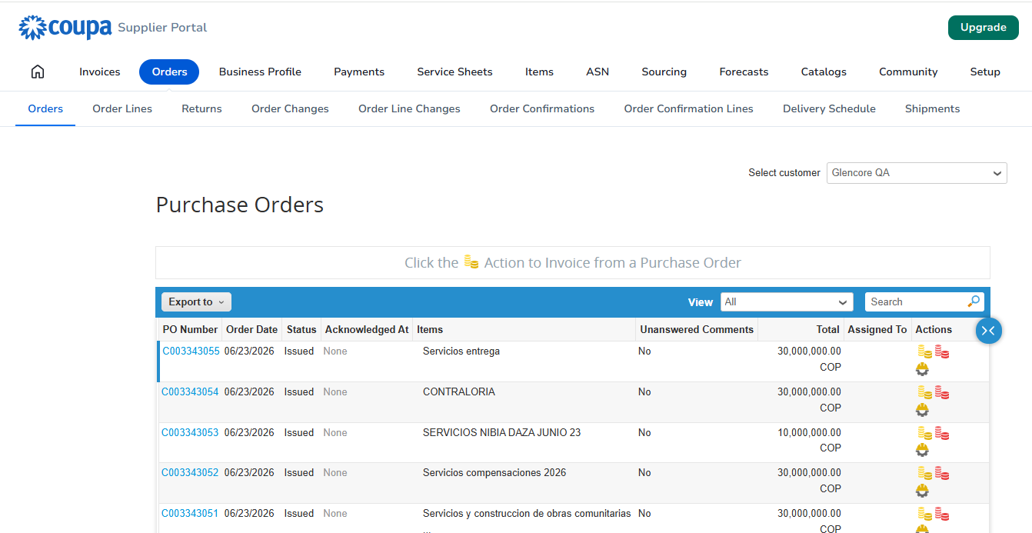
Service Orders issued by Cerrejón
Reference
1
Purchase Order No.
Unique identifier of the Service Order. Click to view the details.
2
Order date
Date Cerrejón issued the Service Order.
3
Status
Current status: Issued = available to record services.
4
Items
Description of the service or item contracted in the order.
5
Total
Total value of the Service Order in the indicated currency.
6
Actions
- Create invoice
- Create Service Entry Sheet

Slide 9
Who performs
this activity?
Service Entry Sheets (SES)
Supplier
In this scenario, executed services are recorded and submitted for review and approval by Cerrejón.
Objective
Scenario 2 – Recording a Service Entry Sheet (SES)
Service Entry Sheets (SES) let you record the services actually performed and reconciled before starting the invoicing process.
The following steps are required to record and submit the Service Entry Sheet (SES) for approval.
Why is it important?
Main activities
✓ Documents the executed services.
✓ Makes information reconciliation easier.
1
Open the corresponding Service Order.
✓ Allows the approval process to begin.
✓ It is a prerequisite for invoicing.
2
Create a new Service Entry Sheet (SES).
Expected result
3
Record the executed services.
Service Entry Sheet (SES) recorded and submitted for approval with the reconciliation certificate attached.
4
Attach the Reconciliation Certificate.
5
Review the entered information.
Important
6
Submit the Service Entry Sheet (SES) for approval.
The recorded information must match the services actually performed and reconciled.

Slide 10


Creating a Service Entry Sheet (SES)
Steps to create a new Service Entry Sheet (SES) from the Service Order.
1
Open the Service Order
From the Coupa Supplier Portal, go to the Orders module and select the corresponding Service Order.
What to do?
1
In the Actions column, select the
Create Service Entry Sheet (SES) icon.
Actions legend
1
Create invoice
Create Service Entry
Sheet (SES)
Viewing
Service Orders
Create Service Entry
Sheet (SES)
Complete the Service
Sheet information
+
i
You will then be taken to the form to complete the general information and the service detail.

Slide 11
Create Service Entry Sheet (SES) – Step 1: General information and service detail
⇄ Status Draft
Service Sheet no. 189
Submitted by
Submission date
Fields to complete
0,00 COP
Carmen Terpel (Supplier)
—
PO No.
No. of Service Sheets per order
Order date
1
Service start date
C003342881
9
17/06/2026
Enter the start date for the executed service period.
Line details
2
End date
1
Consulting second half 2026
0,00 COP
Enter the end date for the executed service period.
PO line
1
2
Due date
* Service start date
* End date
Attachments
1
31/12/2026
Supplier contact email
PO line total
dd/mm/yyyy
dd/mm/yyyy
Add: File | URL | Text
3
Description
None
5.000.000.000,00 COP
Enter a description of the executed service.
Penalties
Currency
Guarantee Deposit
Currency
Other Deductions
Currency
∨
∨
∨
4
Rate
* Description
Worker assignments
4
Rate
Price
5
Quantity
UoM
Select the corresponding rate defined in the Service Order.
No workers available
🔍
Select option ∨
🔍
0,00 COP
View details
5
Quantity
3
Enter the executed quantity for the selected rate.
+ Add detail line
ℹ Note: Fields marked with * are required.
⚠️ Use the search option (magnifier) to find the corresponding rate..
.
.
⚠️ Each Service Entry Sheet (SES) allows recording a maximum of 50 rates.
⚠️ If you need to record more than 50 rates, you must create multiple SES to complete the reconciliation of the executed services.
.

Slide 12
Create Service Entry Sheet (SES) – Step 2: Comments and supporting documentation
i
Instruction: In the Comments section, include a message for the Contract Administrator and attach the reconciliation certificate and relevant supporting documents.
Reference fields
Comments
Mute comments ∨
1
Comments
1
Enter comment
Enter the message that will accompany the Service Entry Sheet (SES).
Enter a message for the Contract Administrator.
2
Attachments
✎
Attach the Reconciliation Certificate and the corresponding supporting documents.
Add File | URL
2
📎 Drag the file here or browse your device
3
Submit
Send a comment notification to a user by entering @name (example: @JohnSmith)
3
Once the information is validated, select Submit to send the SES for the contract administrator’s approval.
Cancel
Save
3
Note: Attachments
Before submitting the SES, make sure the completed Reconciliation Certificate and all required supporting documents are attached. Reconciliation Certificate here ->
This template is preloaded for your reference.
Submit
Attachments
Important note
⚠
If the rates are in another currency, the SES will automatically convert them to the service purchase order currency (which must match the payment currency) using the exchange rate (TRM) on the date the Supplier creates/submits the SES.

Slide 13
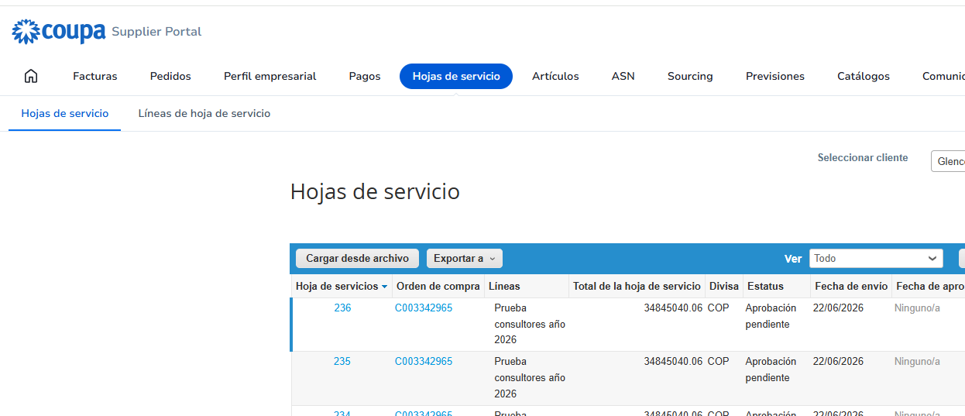
Recording SES via upload template (1-2)
How to access bulk upload of Service Sheets
Steps to access
1
Reference fields
2
Service Entry Sheet (SES)
1
Log in to the portal
Access the Coupa Supplier Portal from your browser.
2
Go to Service Entry Sheets
Click the "Service Sheets" menu in the top navigation bar.
3
Select "Load from file"
Click the "Load from file" button to start the bulk upload.
Load from file
3

Slide 14
Recording SES via upload template (2-2)
Bulk upload lets you record multiple service lines using a CSV template.
📷
Screenshot: Service Sheets bulk-upload screen
Main activities
Select customer
Glencore QA ▾
Service Sheets bulk upload
1
Download the CSV template
Follow these steps to upload Service Sheets
Download the template from the option
available in the portal.
1. Download the CSV template (based on the CSV field separator in your language and region settings)
download ▾
2
Complete the required information
Enter the information for the
executed services.
2. Complete or update the CSV file
• Fields marked with "*" are required.
Validate the uploaded information
• Each uploaded row will create a new Service Sheet.
3
• Click Start upload, and the system will verify the file using the first six rows. The file will be uploaded if there are no errors.
Verify that the rates and lines
match the Service Order.
3. Upload the updated file
Choose File
No file chosen
4
Select the updated file
Attach the completed CSV file.
Note: If you are uploading CSV files that do not contain English characters, see the following help note.
For more information on how to use the template to upload CSV files, see the following help note.
5
Start upload
Start upload
Select Start upload to
process the information.
!
Important note: The rate names must match exactly those defined in the Service Order.

Slide 15
Reference template for SES bulk upload
The template must be completed using the information for the Service Order
and the services actually performed.
X
CSV template structure (sample view)
Main fields
A
B
1
C
D
E
F
G
H
2
3
1
Service Order number
1
Service Sheet
header
1
Purchase order
number
Supplier
name*
Completion Date
Service Start Date
Service
line
Service
description*
Quantity*
Corresponds to the Service Order
linked to the SES.
5
2
Service line
Purchase order
line
number
PO line
number*
2
Completation date and Start date
Period corresponding to the
executed services.
3
Service detail
line
PO number*
Rate
name
4
3
Service description
4
Service Sheet
header
C003342571
EC135590 - EPIROC
COLOMBIA SAS -
901117560
4/6/2026
4/6/2026
Detail of the recorded services.
5
Service line
1
4
Rate Name
6
Service detail
line
C003342571
1 test
Asesoria 3
5
Must match exactly the rate
defined in the Service Order.
7
Service detail
line
C003342571
1 test
Asesoria 4
5
8
Service detail
line
C003342571
1 test
Asesoria 5
5
5
Quantity
9
Service detail
line
C003342571
1 test
Asesoria 6
5
Executed quantity for each recorded
rate.
Headers (do not modify)
Sample data (complete/adjust)
X
Download template
!
?
If in doubt, consult the Contract Administrator before uploading.

Slide 16




Cancellation of a Service Entry Sheet (SES)
This process applies when a previously recorded Service Entry Sheet (SES) needs to be reversed.
Overall process flow
1
2
3
4
!
✓
$
The supplier requests the cancellation of the Service Entry Sheet (SES).
The request is sent for the Contract Administrator’s approval.
If there is an approved invoice for the Service Entry Sheet, once the cancellation is approved the corresponding Credit Note is generated. (Check with the Contract Administrator whether the request is necessary.)
The Contract Administrator notifies Accounts Payable (AP) to replicate the Credit Note in Elipse.
!
Important
✓
Cancelling an SES requires prior approval from the Contract Administrator.
✓
No further action should be taken until the cancellation has been approved.
i
Notes
• The cancellation will reverse the recorded services and their impact on invoicing.
• For any questions about the cancellation status or the Credit Note, contact your Contract Administrator.

Slide 17
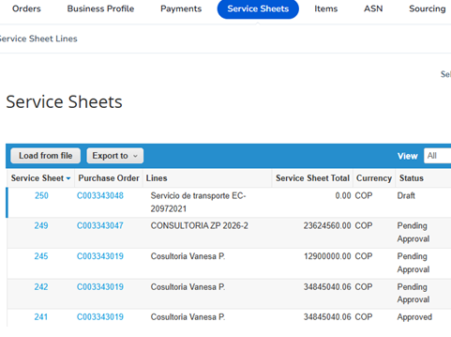
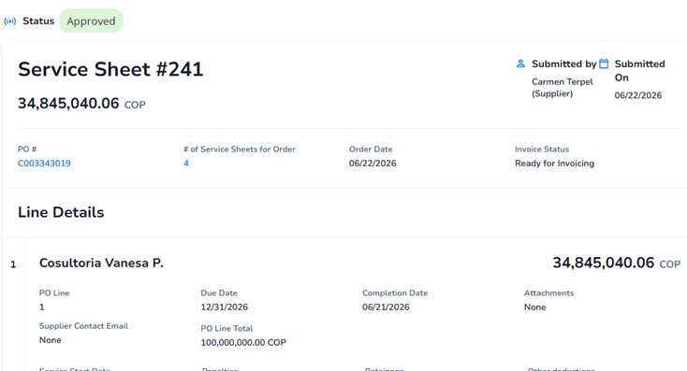
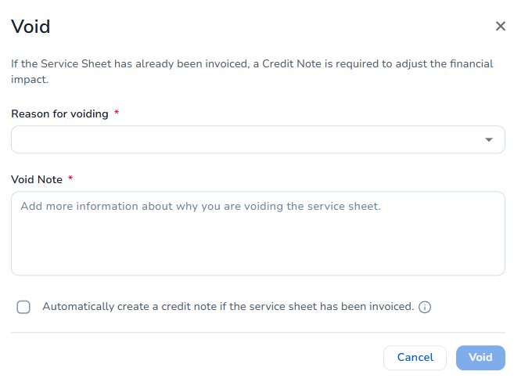
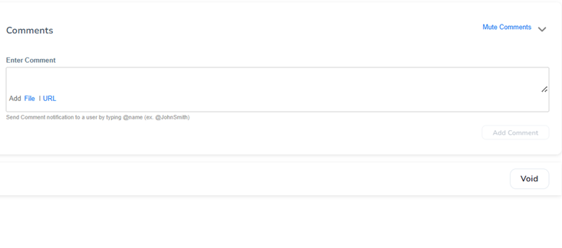
Scenario 3 – Cancellation of a Service Entry Sheet (SES)
1
2
Reference fields
1
Open the list of
Service Sheets
2
Select the Service Sheet to cancel
and review its information
4
3
Select the Cancel option
at the bottom of the screen
4
Complete the cancellation request
(stating the reason for the cancellation request)
3
✓
Expected result
If there is an approved invoice for the Service Entry Sheet, once the cancellation is approved the corresponding Credit Note is generated. (Check with the Contract Administrator whether the request is necessary.)
Cancellation request submitted successfully for review and approval.

Slide 18
Who performs
this activity?
Invoicing
Supplier
This scenario explains how to create and submit invoices for services that have already been executed and approved.
What will we do in this scenario?
Objective
Enable the creation and submission of invoices for services that have already been executed and approved.
The following steps are required to create and submit an invoice for approval.
Main activities
Why is it important?
1
Open the corresponding Service Entry Sheet (SES).
✓ Links the invoice to actual services.
✓ Speeds up validation and payment.
2
Select the option to create an invoice.
✓ Improves traceability of records.
3
Complete the required information.
Expected result
4
Attach the corresponding supporting documentation.
Invoice created and submitted successfully.
5
Review the entered information.
Important
6
Submit the invoice.
To create an invoice, there must be an approved Service Entry Sheet (SES) linked to the Service Order.

Slide 19
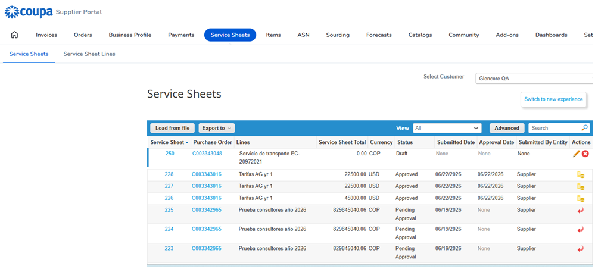
Creating an Invoice
Steps to create a new Invoice from the Service Order.
1
Open the Service Order
From the Coupa Supplier Portal, go to the Orders module and select the corresponding Service Order.
What to do?
1
In the Actions column, select the Create Invoice icon.
Actions legend
1
Create invoice
Viewing
Service Orders
Create Invoice for purchase order #
Complete the Service
Sheet information
+
i
You will then be taken to the form to complete the general information and the service detail.

Slide 20
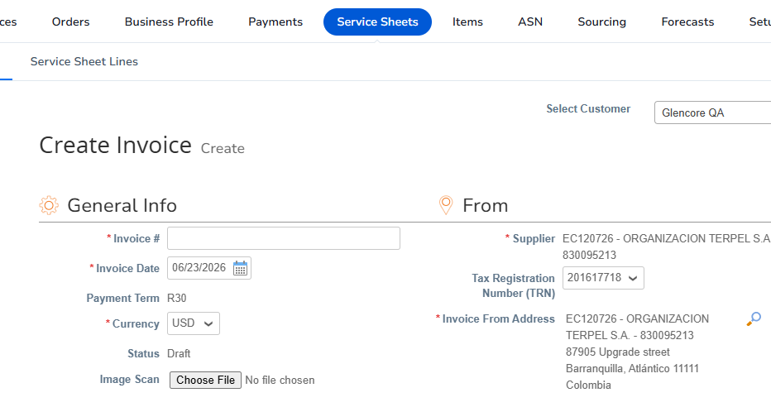
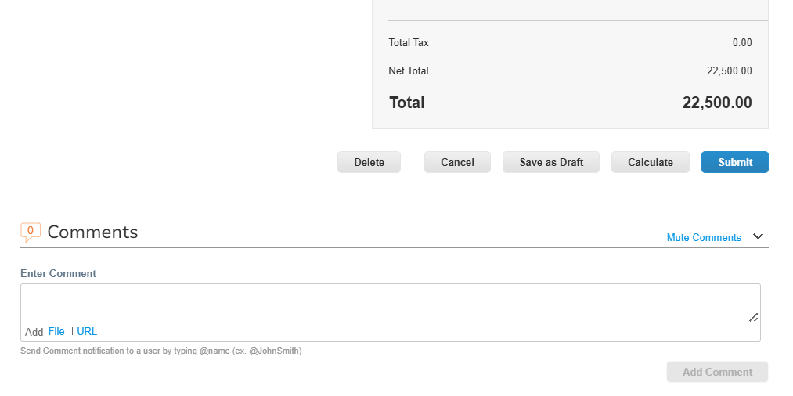
Invoicing
The invoice must be created from an approved Service Entry Sheet (SES).
1. Create invoice from the Service Order
Reference fields
1
1
Create invoice
Available only when there is an approved SES linked to the Service Order.
⚠ If the SES has not been approved, the
"Create invoice" button will not be available.
Important note
Without an approved SES — option not available
Completed form — Submit action
Important note
📌 Each approved Service Entry Sheet (SES) will result in a single invoice.
i
Important considerations
✓
Coupa will not allow creating or submitting an invoice with a value or currency different from what was approved in the SES.
✓
The Supplier can check the status of their invoices directly from the portal in the Invoices menu.

Slide 21
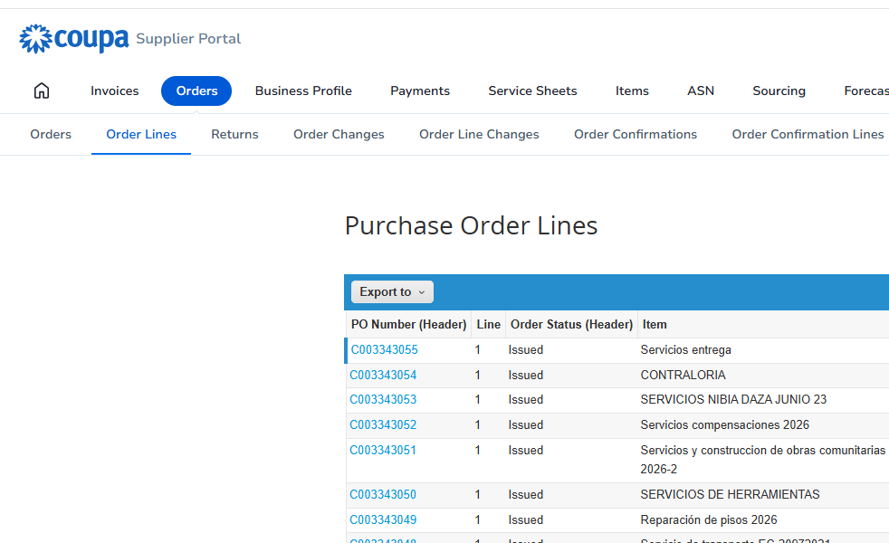
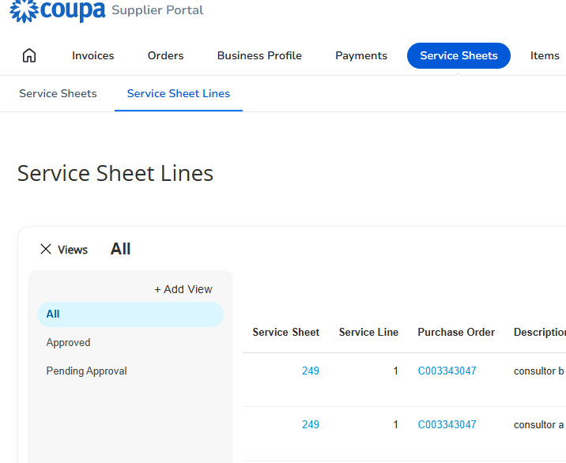
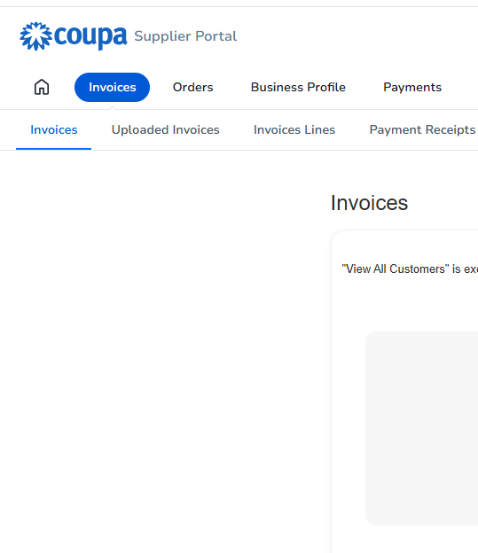
Views for reporting and tracking
From the Coupa Supplier Portal you can view and track your Service Orders, Service Sheets, and Invoices.
i
These views let you monitor the status of your transactions and gain visibility into the process from start to finish.
◎
Objective
Orders – Service Orders
Service Sheets – SES
Invoices
Learn the views available in the Coupa Supplier Portal to track and report on your transactions.
What can you view?
From the following sections of the portal you can view the status and detail of your transactions:
Orders
View your Service Orders issued by Cerrejón.
Service Sheets
From this view you can:
From this view you can:
From this view you can:
View the Service Entry Sheets (SES) created and their approval status.
View the issued Service Orders.
View the recorded Service Entry Sheets (SES).
View the created invoices and their status.
Review the date, status, and detail of the requested services.
See the approval status of each SES.
See the related Service Order or SES number.
Invoices
View your invoices and their processing and payment status.
Track the planning of the services.
Review submission and approval dates.
Track the approval and payment status.
💡
Tip
Validate the recorded value and currency.
You can use the filters and search in each view to quickly find the information you need.
★
Important: Use these views regularly to maintain control and traceability of your services and invoicing.

Slide 22





Next Steps
The following steps prepare us to start operating in the new service-management model with Services Procurement.
Training
✓
Training completed.
You now have the information you need to manage
services and invoicing in Coupa.
✓
Portal access and user validation.
Go-Live
preparation
Make sure your team has access to the Coupa Supplier Portal (CSP) and that users are active and validated.
✓
Invoicing up to date for executed services
Keep invoicing up to date for services previously executed and reconciled with the Contract Administrator designated by Cerrejón.
Go-Live
Planned date: July 2026
From this date, all services must be managed
through Services Procurement in Coupa.
Start of
operation
✓
From Go-Live, services must be recorded via an approved Service Entry Sheet (SES) before invoicing.
Support and Guidance
Post Go-Live support, follow-up, and assistance during the transition and stabilization.
!
Important
- For tool support, contact: Yairinis.Deltoro@cerrejon.com
- For process-related questions, contact the Contract Administrator designated by Cerrejón

Slide 23
Thank you
Time for questions and comments

Slide 24

Glossary
1 of 2
TERM
DEFINITION
Services Procurement
Coupa module that allows managing services through Service Orders, Service Entry Sheets, and Invoices.
CSP (Coupa Supplier Portal)
Portal used by the contractors to manage Service Orders, Service Entry Sheets, and Invoices.
Contract
Document containing the commercial conditions, rates, and terms agreed between Cerrejón and the supplier.
Rate / Tarifa
Rate contractually defined for the provision of a specific service.
Service Order
Document issued by Cerrejón that authorizes and manages the execution of services under a contract determined(Purchase Order for Serv. PO).
Service Entry Sheet (SES) / Service Sheet
Record of services effectively performed by the contractor
Reconciliation Document
Supporting document evidencing services performed and reconciled between Cerrejón and the contractor
Invoice
Document issued by the supplier to request payment for previously approved services.
3-Way Match
Automatic validation between Service Order, Service Entry Sheet, and Invoice before processing and payment.

Slide 25


Glossary
2 of 2
TERM
DEFINITION
TRM
Representative Market Rate used to perform currency conversions when applicable.
Service Administrator
User defined in the Service Order responsible for approving the invoice when it is required a distribution or allocation of Cost Centers
Resource Manager
User defined in the Service Order responsible for reviewing and approving the Service Entry Sheets registered for the corresponding service.
Accounts Payable (AP)
Team responsible for reviewing and processing invoices for payment.
Change Request
Process used to modify an already issued Service Order. Requires a new approval workflow.
Credit Note
Document used to fully or partially reverse a previously registered invoice.
Bulk Upload (Load from File)
Feature that allows registering multiple service lines using a CSV template.
CSV Template
File used to perform bulk upload of Service Entry Sheets.
Unit of Measure (UOM)
Unit used to record service quantities, for example hours, days, or units.

